Slide 1
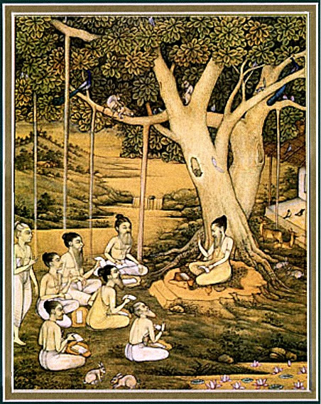
Srimad bhagavataM 1.15.11 – 17
Remembering
Krsna

Slide 2
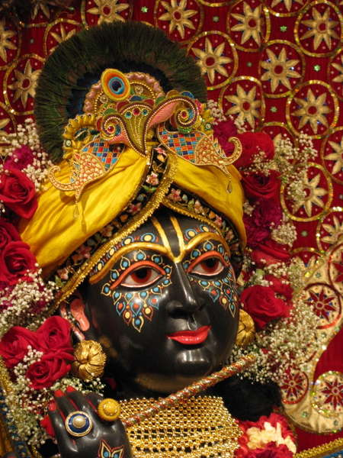
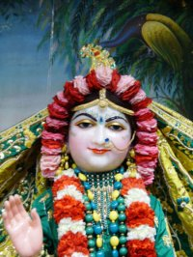
SB 1.2.4 narayanam namaskrtyam naram caiva narottamam devim sarasvatim vyasam tato jayam udirayet
Translation: Before reciting this Srimad Bhagavatam, which is the
very means of conquest, one should offer respectful obeisances
unto the Personality of Godhead, Narayana, unto Nara-Narayana
Rsi, the supermost human being, unto mother Sarasvati, the
goddess of learning, and unto Srila Vyasadeva, the author.

Slide 3
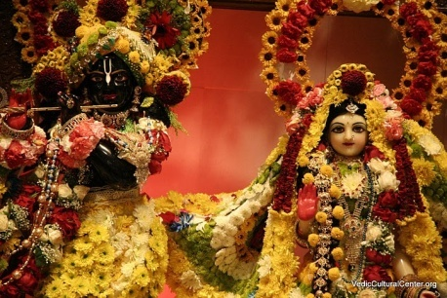
nasta-prayesy abhadresu nityaḿ bhagavata-sevaya bhagavaty uttama-sloke bhaktir bhavati naisthiki
SB 1.2.18
Translation: By regular attendance in classes on the
Bhagavatam and by rendering of service to the pure devotee,
all that is troublesome to the heart is almost completely
destroyed, and loving service unto the Personality of
Godhead, who is praised with transcendental songs, is
established as an irrevocable fact.

Slide 4
So far …
1.15.1 – 10 Arjuna narrates incidents how the
Lord empowered him
1.15.11 – 17 More pastimes
Notes:
1-10:
Arjuna returns for Dwarka
Begins to tell Krsna left
Quotes incidents of empowerment
11-17: more incidents

Slide 5
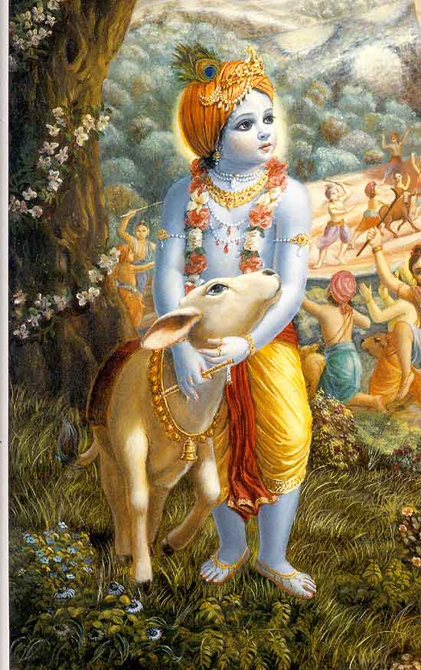
SB 1.15.11 – 17
Remembering Krsna

Slide 6
Section outline
Durvasa muni and the Akshayapatra
Visiting the Heavenly planets
13 Gave shelter to the demigods
Regaining King Virata’s cows
Reduction of Kaurava’s duration of life
Protection against the Kauravas
17 Thirsty horses

Slide 7
SB 1.15.11
yo no jugopa vana etya duranta-kåcchräd
durväsaso 'ri-racitäd ayutägra-bhug yaù
çäkänna-çiñöam upayujya yatas tri-lokéà
tåptäm amaàsta salile vinimagna-saìghaù
During our exile, Durväsä Muni, who eats with his ten
thousand disciples, intrigued with our enemies to put us
in dangerous trouble. At that time He [Lord Kåñëa],
simply by accepting the remnants of food, saved us. By
His accepting food thus, the assembly of munis, while
bathing in the river, felt sumptuously fed. And all the
three worlds were also satisfied.

Slide 8
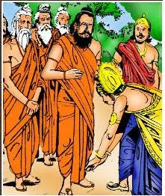
1.15.11 Krsna - The Supreme Mystic
History of Durvasa muni
Durvasa muni’s visit to Pandavas
Lessons
- Yogesvara Krsna
- Offer at home to the Lord
- Difficulties increase devotee’s devotion
- Draupadi’s attachment to the Lord.
“This incident proves that the Lord is the greatest mystic, and therefore He is known as Yogeçvara. Another instruction is that every householder must offer food to the Lord, and the result will be that everyone, even a company of guests numbering ten thousand, will be satisfied because of the Lord's being satisfied. That is the way of devotional service.”
Notes:
History
- Brahmana mystic
- Incarnaton of Lord Siva
- Kumari kunti pleases Durvasa
- Could travel in Space – 1 year – ambrish maharaja
Visit the pandavas
- Duryodhana’s plot
- Draupadi’s calling for Krsna

Slide 9
SB 1.15.12
yat-tejasätha bhagavän yudhi çüla-päëir
vismäpitaù sagirijo 'stram adän nijaà me
anye 'pi cäham amunaiva kalevareëa
präpto mahendra-bhavane mahad-äsanärdham
It was by His influence only that in a fight I was able to astonish the personality of god Lord Çiva and his wife, the daughter of Mount Himalaya. Thus he [Lord Çiva] became pleased with me and awarded me his own weapon. Other demigods also delivered their respective weapons to me, and in addition I was able to reach the heavenly planets in this present body and was allowed a half-elevated seat.

Slide 10
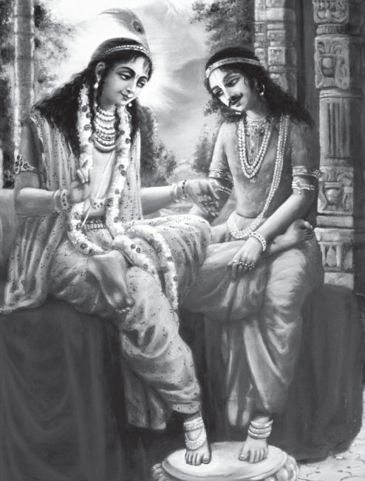
1.15.12 Achieve all favors
Demigods vs Supreme Lord
- Their devotees
- Their benefits
Arjuna visits Heaven
“The instances described by Arjuna during his friendly dealings with Lord Çré Kåñëa are instructive for all who may be convinced by the lessons that one can achieve all favors simply by pleasing the Supreme Lord Çré Kåñëa, whereas the devotees or worshipers of the demigods may achieve only partial benefits, which are also perishable, just as the demigods themselves are.”
Notes:
Self-same body
- Only one who does pious acts and that too in next life
- Moderns scientists attempts fail
- Ppl influenced by passion and ignorance
- Heavenly planets - goodness

Slide 11
SB 1.15.13
tatraiva me viharato bhuja-daëòa-yugmaà
gäëòéva-lakñaëam aräti-vadhäya deväù
sendräù çritä yad-anubhävitam äjaméòha
tenäham adya muñitaù puruñeëa bhümnä
When I stayed for some days as a guest in the heavenly planets, all the heavenly demigods, including King Indradeva, took shelter of my arms, which were marked with the Gäëòéva bow, to kill the demon named Nivätakavaca. O King, descendant of Ajaméòha, at the present moment I am bereft of the Supreme Personality of Godhead, by whose influence I was so powerful.

Slide 12
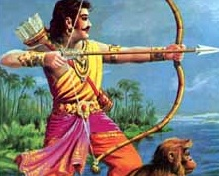
1.15.13 Giving shelter to the Demigods
“The heavenly demigods are certainly more intelligent, powerful and beautiful, and yet they had to take help from Arjuna because of his Gäëòéva bow, which was empowered by the grace of Lord Çré Kåñëa. The Lord is all-powerful, and by His grace His pure devotee can be as powerful as He may desire, and there is no limit to it. And when the Lord withdraws His power from anyone, he is powerless by the will of the Lord.”
Practical Application
- Jala duta diary
- Recognizing Krsna’s gifts
- Becoming an Instrument
Notes:
Incident how Arjuna was defeated
Make me dance, give me power to speak, fulfill the purport of bhakti vedanta.
- should not be proud of gifts
- use it in Krsna’s service.
- instrument – greatest thing, does not take credit (knife)

Slide 13
SB 1.15.14
yad-bändhavaù kuru-baläbdhim ananta-päram
eko rathena tatare 'ham atérya-sattvam
pratyähåtaà bahu dhanaà ca mayä pareñäà
tejäspadaà maëimayaà ca håtaà çirobhyaù
The military strength of the Kauravas was like an ocean in which there dwelled many invincible existences, and thus it was insurmountable. But because of His friendship, I, seated on the chariot, was able to cross over it. And only by His grace was I able to regain the cows and also collect by force many helmets of the kings which were bedecked with jewels that were sources of all brilliance.

Slide 14
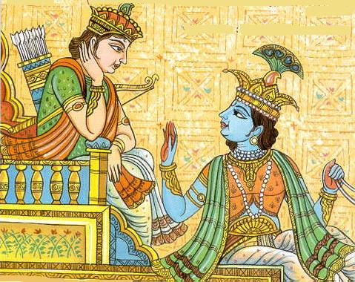
1.15.14 Krsna’s grace
Vanquish Kauravas due to Krsna’s grace
Regaining King Virata’s cows
Practical Application
- Giving credit
- Hot potato
“On the Kaurava side there were many stalwart commanders like Bhéñma, Droëa, Kåpa and Karëa, and their military strength was as insurmountable as the great ocean. And yet it was due to Lord Kåñëa's grace that Arjuna alone, sitting on the chariot, could manage to vanquish them one after another without difficulty.”
Notes:
Kauravas insurmountable like an ocean
- Kauravas many changes of commanders
- Arjuna remained thru out
Virata’s cows
- incognito, minister attracted to draupadi, bhima bet him to pulp.
- kauravas suspect – want to reveal – steal the cows
- Arjuna with King’s son went to defeat them.
- Virata offers his daughter to marry Arjuna. Arjuna being teacher refuses and accepts as daughter-in-law.
- Marries abhimanyu – parikshit – war.

Slide 15
SB 1.15.15
yo bhéñma-karëa-guru-çalya-camüñv adabhra-
räjanya-varya-ratha-maëòala-maëòitäsu
agrecaro mama vibho ratha-yüthapänäm
äyur manäàsi ca dåçä saha oja ärcchat
It was He only who withdrew the duration of life from everyone and who, in the battlefield, withdrew the speculative power and strength of enthusiasm from the great military phalanx made by the Kauravas, headed by Bhéñma, Karëa, Droëa, Çalya, etc. Their arrangement was expert and more than adequate, but He [Lord Çré Kåñëa], while going forward, did all this.

Slide 16
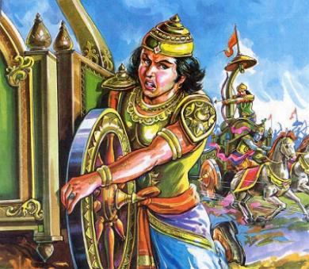
1.15.15 Lord’s affection
Supersoul
Lord’s will
Lord’s affection
Notes:
Supersoul
- 15.15 – sarvasya caham
- decreased duration of life
Will
- By His will he killed all his opponents.
- Rakhe Krsna mare ke, mare Krsna rakhe ke
- You make ur plan, I make my plan but Krsna has His plan.
- 3 fold bending form – cannot know the will
- Whole life trying serve the will as given by S.M
Affection
- S.P + Malati mathaji
- S.G + Rasika mathaji

Slide 17
1.15.15 Lord’s affection
“The other party was equipped with all military strength supported by big generals like Bhéñma, Droëa and Çalya and it would have been physically impossible for Arjuna to win the battle had the Lord not helped him by every kind of tactic. Such tactics are generally followed by every statesman, even in modern warfare, but they are all done materially by powerful espionages, military tactics and diplomatic maneuvers. But because Arjuna was the Lord's affectionate devotee, the Lord did all this Himself without personal anxiety by Arjuna. That is the way of the devotional service to the Lord.”

Slide 18
SB 1.15.16
yad-doùñu mä praëihitaà guru-bhéñma-karëa-
naptå-trigarta-çalya-saindhava-bählikädyaiù
asträëy amogha-mahimäni nirüpitäni
nopaspåçur nåhari-däsam iväsuräëi
Great generals like Bhéñma, Droëa, Karëa, Bhüriçravä, Suçarmä, Çalya, Jayadratha, and Bählika all directed their invincible weapons against me. But by His [Lord Kåñëa's] grace they could not even touch a hair on my head. Similarly, Prahläda Mahäräja, the supreme devotee of Lord Nåsiàhadeva, was unaffected by the weapons the demons used against him.

Slide 19
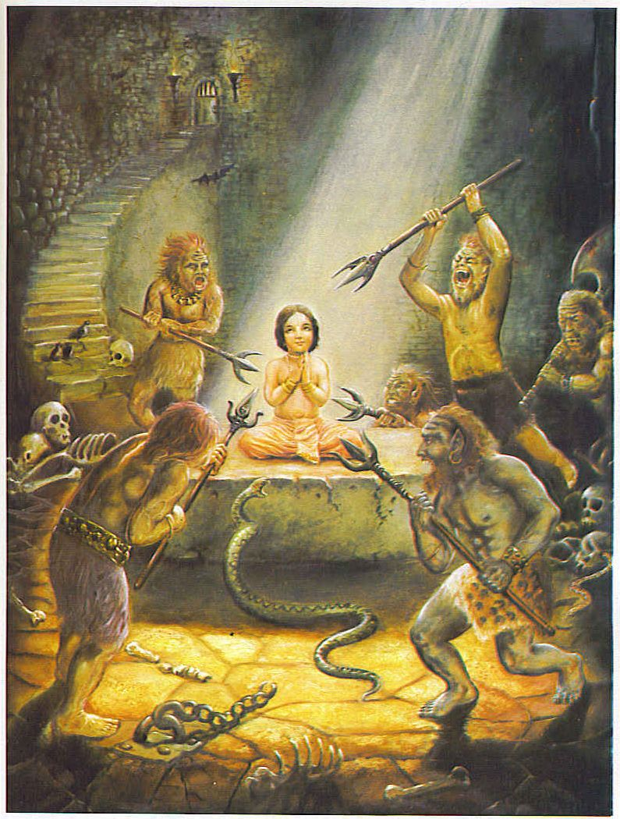
1.15.16 Protection against weapons
Prahlad maharaja
Great generals
“He was thrown in a fire, in boiling oil, from the top of a hill, underneath the legs of an elephant, and he was administered poison. At last the father himself took up a chopper to kill his son, and thus Nåsiàhadeva appeared and killed the heinous father in the presence of the son. Thus no one can kill the devotee of the Lord. Similarly, Arjuna was also saved by the Lord, although all dangerous weapons were employed by his great opponents like Bhéñma.”
Notes:
Prahlad maharaja
- 5 years, object of envy
2. Lord protects his devotee always
- need not be body, but their consciousness.

Slide 20
SB 1.15.17
sautye våtaù kumatinätmada éçvaro me
yat-päda-padmam abhaväya bhajanti bhavyäù
mäà çränta-väham arayo rathino bhuvi-ñöhaà
na präharan yad-anubhäva-nirasta-cittäù
It was by His mercy only that my enemies neglected to kill me when I descended from my chariot to get water for my thirsty horses. And it was due to my lack of esteem for my Lord that I dared engage Him as my chariot driver, for He is worshiped and offered services by the best men to attain salvation.

Slide 21
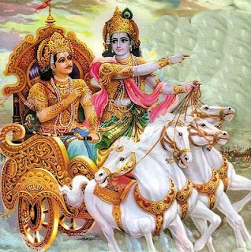
1.15.17 Lord’s protection
All worshipable Lord
Purpose of Lord’s descent
Thirsty horses
“While playing in such a perfect transcendental relation, the devotee forgets, by the internal potency of the Lord, that his friend or son is the Supreme Personality of Godhead, although sometimes the devotee is bewildered by the acts of the Lord. After the departure of the Lord, Arjuna was conscious of his great friend, but there was no mistake on the part of Arjuna, nor any ill estimation of the Lord. Intelligent men are attracted by the transcendental acting of the Lord with a pure, unalloyed devotee like Arjuna.”
Notes:
Worshipable Lord
- impersonalists
- devotees
- lower – great historical personality.
Lord’s descent
- 4.8 – paritranaya sadhunam
- To attract by His pastimes
- Most perfect master, friend, son and lover
- Intelligent men get attracted by loving dealings with His devotee.
Thirsty horses
- boring the ground
- Arjuna bore with a sharp arrow
- Modern unable to dig immediately
- Cured thirst of Arjuna

Slide 22
Summary
The Supreme mystic
Achieve all favors
Becoming an Instrument
Give credit
Lord’s affection
Lord’s protection

Slide 23
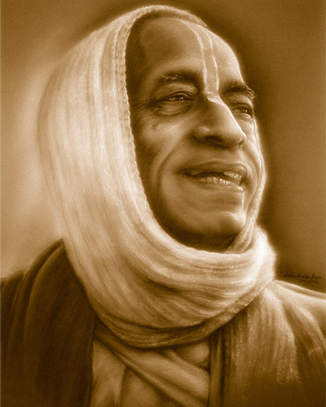
References
HH Romapada maharaja’s lectures on this section.
HG Bhurijana prabhu’s overview class on IskconDesireTree.
Srila Prabhupada’s purports.
All glories to Srila Prabhupada!

